Slide 1

Machine Learning and Data Analytics for Auditing with Microsoft Excel and
Microsoft Azure Machine Learning Studio

Slide 2

Instructor - John Phillips, CFO Analytics Training, LLC I am a Certified Public Accountant and IBM Certified in IBM SPSS Modeler Data Mining.

Slide 3
Introduction

Slide 4
AICPA Definition:
Audit data analytics are defined as “the science and art of discovering and analyzing patterns, identifying anomalies, and extracting other useful information in data underlying or related to the subject matter of an audit through analysis, modeling, and visualization for the purpose of planning or performing the audit.”

Slide 5
Uses of Audit Data Analytics
Risk Assessment Procedures
Fraud risk Assessment
Substantive Analytical Procedures
Test of Details

Slide 6
Course Outline:
Data Visualizations:
Significant Accounts
Account Variance Analysis
Financial Ratios
Fraud Ratios
Inventory Ratios
General Ledger Risk Assessment
Sales Analysis
Descriptive Statistics :
Descriptive Statistics in Excel
Machine Learning and Predictive Analytics:
Excel:
Linear Regression/Time Series:
Simple Linear Regression – AutoFill
Linear Regression – Advertising Spend
Multiple Linear Regression – Health Club Sales
Time Series – Sales Forecast

Slide 7
Course Outline – Continued
Microsoft Azure Machine Learning Studio/ Excel:
Logistic Regression – Insurance Fraud (Azure)
Decision Tree Algorithm – Journal Entry Testing (Azure)
Anomaly/Outlier Detection:
  K-Means Clustering )Azure)
  Z-Score (Excel)
  Correlation/Scatter Plot (Excel)
Text Analytics - Sentiment Analysis – Tweets (Azure)
Benford’s Law and Miscellaneous CAATS:
Benford’s Law
Round Numbers
Duplicate Numbers
Sequence Gap
Fuzzy Matching
Merging Tables/Two-Way Matching

Slide 8
Data Visualization

Slide 9
Data Visualization
Data visualization has become the preferred method to emphasize financial information – a picture is worth a thousand words!
Changes, patterns and trends that may go unnoticed in spreadsheets, etc. are accentuated with data visualization.
Financial professionals are now being encouraged to become “storytellers” to better communicate financial information. Data visualization accomplishes this with user-friendly reports that will highlight critical information and insights. It’s an excellent way to help document the auditor’s preliminary risk assessment.

Slide 10
Data Visualization Case Studies
Case Study
Significant Accounts
Account Variance Analysis
Fraud Ratios
Financial Ratios
Inventory Turnover
General Ledger Risk Assessment
Sales Analysis
Purpose
Risk assessment
Risk assessment – analytical procedure – trend analysis
Fraud risk assessment
Risk assessment – analytical procedure – ratio analysis
Fraud risk assessment
Risk and fraud assessment
Risk assessment – analytical procedure – trend analysis

Slide 11
Descriptive Statistics

Slide 12
Descriptive Statistics
Descriptive Statistics are used to quantitatively describe or summarize a collection of data. They can be used to perform a preliminary exploration of the data. They deal with past information – What has happened.

Slide 13
Descriptive Statistics in Excel
Mean
Median
Mode
Range
Minimum
Maximum
Sum
Count
Average of the dataset
Middle value of the dataset
The most common value in the dataset
The difference between the largest and smallest values
The smallest value in the dataset
The largest value in the dataset
The sum of all the values in the dataset
The number of values in the dataset

Slide 14
Descriptive Statistics in Excel
Standard Deviation
Sample Variance
Standard Error
Kurtosis
Skewness
Shows how widely dispersed the data is around the mean
Deviation of each value from the mean
Proximity of sample values to the mean
Shows if the dataset is peaked or flat
Shows if the dataset is symmetrical around the mean

Slide 15
Case Study
Case Study
Sales/Sales Return Analysis
Purpose
Risk Assessment Procedures

Slide 16
Machine Learning Introduction & Linear Regression

Slide 17
Definitions
Artificial intelligence is the simulation of human intelligence processes by machines i.e. autonomous cars and robots.
Machine learning is a branch of artificial intelligence in which computers learn from data, identify patterns and can make predictions.
Predictive Analytics deals with extracting information from historical data and using it to predict trends and meaningful behavior patterns – What could happen in the future.

Slide 18
Machine Learning Steps
Data Preparation – This phase involves all the procedures to construct the final dataset. Data preparation is often the most time consuming phase and includes data transformation (i.e. joining two data sets together), data cleansing and data formatting.
Modeling – This phase involves selecting and applying the modeling techniques to be used. Models are the application of algorithms to data to generate predictions and make inferences about relationships. An algorithm is essentially a formula or series of steps to solve a mathematical problem.
Evaluation - It’s also critical to evaluate the effectiveness of the model. The model is tested by using a test data set of known values and comparing this to the predicted values.

Slide 19
Modeling Methods – Supervised vs Unsupervised
There are two basic types of machine learning modeling techniques – supervised and unsupervised.
Supervised techniques are used when you have a specific target you want to predict (for example will this customer churn or not churn). We’ll do case studies using the following supervised modeling techniques: Linear Regression, Logistic Regression, and Decision Trees.
Unsupervised learning, on the other hand, has no target variable to predict but finds hidden patterns in the dataset and includes clustering and association rules. We’ll do a case study using K-Means Clustering.

Slide 20
Linear Regression:
Regression is a popular method to discover a relationship between variables.
In linear regression, we evaluate whether one variable, the dependent or target variable (Y on a graph), can be explained as a function of another, called the independent or predictor variable (X). When there are two or more independent variables it’s called multiple regression.
A regression line is drawn to minimize the sum of squared deviations and this line can be used to predict Y values for new values of X. The mathematical formula is Y=a+bX – where a is the intercept and b is the slope.
Linear regression is used when we have numeric predictor variables and a numeric target variable (i.e. predict sales amount from the amount of advertising spend).

Slide 21
Sales vs Advertising Spend

Slide 22
Interpret Regression Analysis Results
Result metrics provided by Regression include:
R squared – measures how close the data is to the fitted regression line – is between 0 and 1 – the closer to 1 the better the model.
P-Value – measures the statistical significance of the relationship between the variables. Rule of Thumb < .05.
t statistic – similar to the P-value – measures the relationship between the independent and dependent variable. Rule of Thumb - >2.

Slide 23
Time Series Regression
Time series regression discovers patterns in historical data and then extrapolates this into future periods.
It can be used to predict the current year sales amounts based on prior periods figures.
In many business situations there is a seasonality pattern that must be taken into account in the forecast.

Slide 24
Case Studies
Case Study
Simple Linear Regression – fill series - Forecast
Linear Regression
Multiple Linear Regression – Health Club Sales
Time Series – Sales Forecast
Purpose
Risk assessment – analytical procedure - trend
Example - Sales by Advertising Spend
Fraud Risk Assessment
Substantive Testing - Sales

Slide 25
Machine Learning – Logistic Regression

Slide 26
Logistic Regression
Logistic regression estimates the probability of a binary categorical target based on one or more predictor or independent variables. Categorical variables are non-numeric and binary is data that can only take on two values (i.e. yes/no; success/failure) . These types of models are referred to as Classification Models. If a model has a numeric target, such as linear regression, it’s referred to as a Regression Model.
Logistic regression can answer questions such as the probability that a debtor will pay back a loan or that a customer will churn.
Unlike linear regression which has a numerical target and fits to a straight line, logistic regression fits to an S-shaped curve – the so called sigmoid curve.
Logistic regression normally requires numeric input (predictor) variables but if there are categorical input variables, Microsoft Azure will convert them. This is done by using “Dummy Variables” 1 if the category is present, 0 if the category is absent (i.e Married – 0, No; 1, Yes). Note: Microsoft Azure initially classifies non-numeric variables as String – they may need to be further characterized as Categorical.
Logistic regression will generate a prediction (i.e. fraud – yes/no) and a confidence percentage.

Slide 27
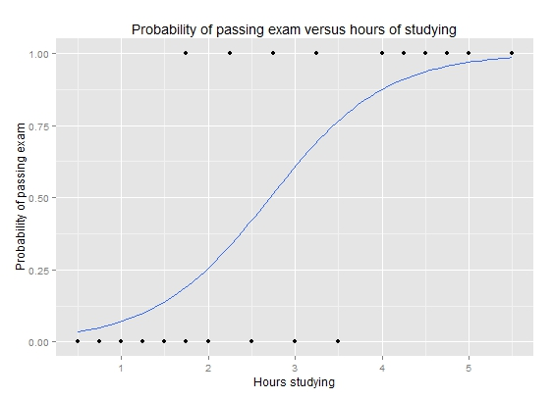
Classification Models
In a classification model like Logistic regression, the goal is to predict what target class a data set belongs to.
For example, if we have a set of predictors for credit scoring such as age, education, income, debt/ratio we could have a target of loan default yes/no.
In the model training process, a historical data set (training set) is used where the predictors and target are known.
The classification algorithm find relationships between the predictors and the target.
These relationships are then applied to a different data set (scoring set) in which the target is unknown and the model predicts the outcome i.e. in our example default yes/no and the probability of this classification.

Slide 28
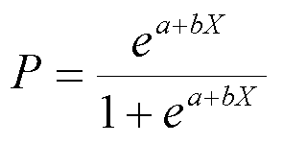
Logistic Regression Equation

Slide 29
Classification Models
In a classification model like Logistic regression, the goal is to predict what target class (i.e. yes/no, true/false) a set of predictor variables belongs to.
For example, if we have a set of predictors for credit scoring such as age, education, income, debt/ratio we could have a target of loan default yes/no.
The model training process:
A historical data set (training set) is used where the predictors and target are known.
The classification algorithm find relationships between the predictors and the target.
These relationships are then applied to a different data set (scoring set) in which the target is unknown and the model predicts the outcome i.e. in our example default yes/no and the probability of this classification.

Slide 30
Classification Model Evaluation
It’s also critical to evaluate the effectiveness of the classification model.
The model is tested by setting aside a portion of the training data set which is referred to as the test data set.
The test data set is run through the model and the results are compared to the original known values.
The result is called a confusion matrix and it displays the number of correct and incorrect predictions.

Slide 31
Confusion Matrix
The confusion matrix summarized the following correct/incorrect predictions:
True Positive – actual class was positive and was predicted as positive.
False Positive – actual class was negative and was predicted as positive.
True Negative – actual class was negative and it was predicted as negative.
False negative – actual class was positive but was predicted as negative.

Slide 32
Classification Model Evaluation
Some important metrics include the following:
Receiver Operator Characteristic (ROC) Curve – Graphically plots the rate of true positives to false positives. Generally the larger the “Area Under the Curve” the better the model. Rule of thumb > .80 is a good model.
Accuracy – what % of all predictions are correct.
Recall or Sensitivity - the proportion of actual positive cases that are correctly classified.

Slide 33
Case Study
Case Study
Insurance Fraud
Purpose
Substantive testing/claims - Fraud

Slide 34
Machine Learning - Decision Trees

Slide 35
Decision Trees
Decision trees are one of the most popular techniques for classification. Like logistic regression, decision trees can also be used for categorical targets. For example, in our case study we’ll predict possible bad debts from a customer accounts receivable list.
A decision tree is in the form of a decision flowchart (resembles an inverted tree) where the predictor variables are tested in each node and are split in accordance with importance based on the particular algorithm’s criteria.
At the bottom of the decision tree branch is a leaf node where a prediction about the target variable is made based on the variables leading to that leaf node.

Slide 36
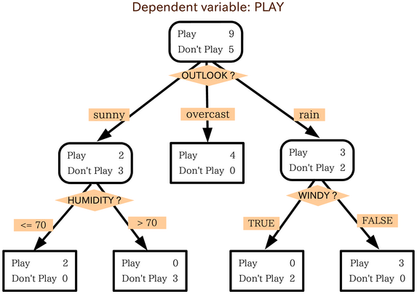
Decision Trees:
Decision trees are one of the most popular techniques for classification.
A decision tree is in the form of a decision flowchart (resembles an inverted tree) where the predictor variables are tested in each node and are split in accordance with importance based on the particular algorithm’s criteria.
At the bottom of the decision tree branch is a leaf node where a prediction about the target variable is made based on the variables leading to that leaf node.
Decision Trees:
Decision trees are one of the most popular techniques for classification.
A decision tree is in the form of a decision flowchart (resembles an inverted tree) where the predictor variables are tested in each node and are split in accordance with importance based on the particular algorithm’s criteria.
At the bottom of the decision tree branch is a leaf node where a prediction about the target variable is made based on the variables leading to that leaf node.
Decision Trees:
Decision trees are one of the most popular techniques for classification.
A decision tree is in the form of a decision flowchart (resembles an inverted tree) where the predictor variables are tested in each node and are split in accordance with importance based on the particular algorithm’s criteria.
At the bottom of the decision tree branch is a leaf node where a prediction about the target variable is made based on the variables leading to that leaf node.
Decision trees are one of the most popular techniques for classification.

Slide 37
Decision Trees - continued
Some of the most popular decision tree algorithms are: ID3, CART and CHAID. They vary primarily due to the process used for splitting the variables by importance in each node.
s are popular for the following reasons:
Decision trees are popular for the following reasons:
They are easy to understand.
They are easy to build.
The input predictor variable can be categorical or numeric.
They can handle missing data automatically.They are easy to understand.
They are easy to build.
The input predictor variables can be nominal or continuous.
They can handle missing data automatically.

Slide 38
Case Study
Case Study
Journal Entry Testing
Purpose
Substantive testing

Slide 39
Journal Entry Testing

Slide 40
Journal Entry Testing
AU-C Section 240, Consideration of Fraud in a Financial Statement Audit, requires the auditor to test the appropriateness of journal entries recorded in the general ledger and other adjustments made in the preparation of the financial statements.

Slide 41
AICPA Practice Alert 2003-02
Selecting Journal Entries for Testing Examples:
Made to unrelated, unusual or seldom-used accounts.
High-dollar debits or credits.
Made by individuals who typically do not make journal entries or senior management.
Recorded at the end of the period.
That contain round numbers
Approvals are required and made.
That aren’t consistent with Benford’s Law.
Made on weekends or holidays.
Verify no gaps in journal entry number sequence.

Slide 42
Machine Learning -Anomaly/Outlier Detection

Slide 43
Anomaly/Outlier Detection
Anomaly/Outlier detection is one of the most useful machine learning/ data analytics tools for the auditor
Anomaly/Outlier detection is the identification of data points or observations that differ significantly from the majority of the data.
We’ll perform the following case studies:
K-Means Clustering – Azure – Multiple Variables
Z-Score – 1 Variable – Excel
Scatter Plot/Correlation – 2 Variables – Excel

Slide 44
Unsupervised Learning: K-Means Clustering
As mentioned in the previous section, unsupervised learning has no target variable to predict, instead the dataset is clustered into natural groupings.
Two of the most popular unsupervised modeling methods are clustering and association rules.
Cluster analysis forms groups or clusters of similar records. The purpose is to characterize these clusters in ways that are useful for analysis.

Slide 45
K-Means Clustering
The K-Means method is the most popular and simplest clustering algorithm.
This method is based on the theory of minimizing the least squared distance from the center points of the clusters, the centroid.
It accomplishes this by comparing the averages (means) of the variables to form the clusters.
K-Means clustering is often used for customer segmentation and anomaly detection. Our case study will utilize anomaly detection to find outliers in our data.
K-means works best with numeric inputs but categorical variables can be converted with dummy variables if necessary.

Slide 46
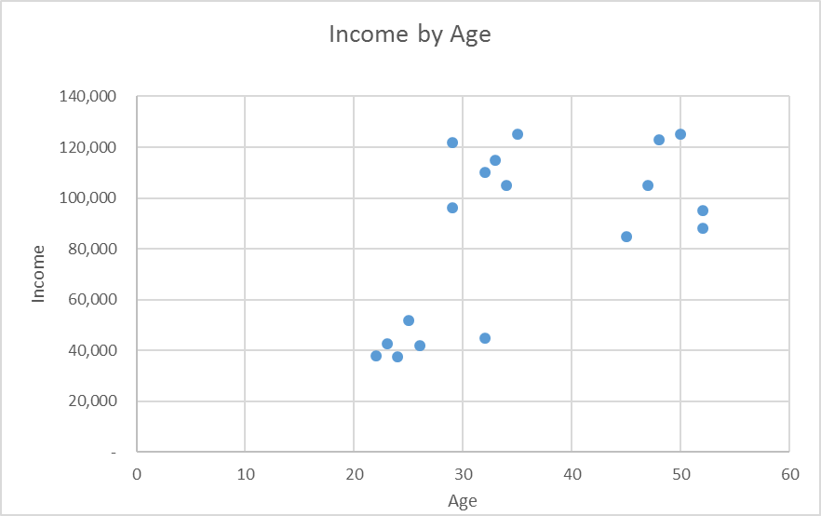

Slide 47
Case Study
Case Study
Service Company Inventory
Purpose
Substantive testing/inventory - Fraud

Slide 48
Z-Score
Z-Score – is the number of standard deviations from the mean. It’s a standard score and can be used to identify outliers in a dataset with one variable.
A Z-Score larger than three can be considered an outlier and should be investigated further.
Case Study: Purpose:
Inventory Listing Substantial testing/inventory

Slide 49
Correlation
Correlation is a measure of how strong the relationships are between variables in a dataset.
It provides an indication of the linear relationship between two variables.
Correlations can be either positive or negative.
A scatter plot is an excellent way to visualize the correlation between two variables and to identify outliers.
The strength of the correlation can be measured by the correlation coefficient which can be produced in Excel. It ranges from -1.0 to +1.0. The closer the coefficient is to 1 or to -1, the stronger it is.

Slide 50
Correlation is not Causation!
Just because variables are related doesn’t mean that one causes the other.
We obtain statistical inferences not exact answers.
Data analytics provides business insights that will prompt the auditor to perform further analysis.

Slide 51
Case Study
Case Study
Sales/Sales Return Analysis
Purpose
Fraud Risk Assessment

Slide 52
Text Analytics

Slide 53
Text Analytics
It’s estimated that 80% of the Big Data available today is in the form of unstructured textual data – i.e. emails, posts on social media, online reviews, call center notes.
Text analytics helps to unlock meaning, insights and patterns in unstructured data.
Structure is added to text documents by parsing out the occurrence of common words – the so called “bag-of-words”. Datasets can be created from the bag-of-words and machine learning techniques applied both supervised and unsupervised.
Text sentiment analysis is a subset of text analytics that analyzes the tone of what people think about a company, product, etc. on social media or other public forums. It determines whether the post, review, etc. is positive, negative or neutral.

Slide 54
Case Study
Case Study
Lawson Mowers
Purpose
Sentiment analysis of new product

Slide 55
Benford’s Law and Miscellaneous CAATS

Slide 56
AU-C 240 Consideration of Fraud
The auditor is responsible for obtaining reasonable assurance that the financial statements as a whole are free from material misstatement whether caused by fraud or error.
The auditor’s objectives regarding fraud:
Identify and assess the risks of material misstatement of the financial statement due to fraud.
Design and implement appropriate responses to the assessed risks of material misstatement due to fraud and obtain sufficient appropriate audit evidence. This may include employing computer-assisted audit techniques for more extensive testing.
Appropriately respond to identified or suspected fraud.

Slide 57
Benford’s Law
Named after Frank Benford, a physicist at the GE Research Laboratories, who noticed that the beginning pages of his logarithm table books were more worn than those at the end.
In 1938, he developed his mathematical theory of leading digits. Benford’s Law states that the number 1 will be the leading digit in a naturally occurring data set 30.1% of the time; the number 2 will be the leading digit 17.6% of the time; the numbers 3 through 9 will be the leading digit with decreasing frequency.
Benford’s Law works well will may accounting data sets: accounts payable transactions, inventory prices and credit card transactions. It doesn’t work well for data sets with assigned numbers (i.e. social security numbers) or built-in maximum or minimum amounts (i.e. minimum wage rates).
Benford’s Law is a valuable tool to help detect fraud. When fraudulent transactions are created, they often deviate from the Benford’s Law’s predictions and can be investigated further.

Slide 58
Miscellaneous CAATS (Computer-Aided Audit tools)
Round Numbers – the existence of round numbers may indicate fraud. Excels’s MOD function can be used to identify them.
Duplicate Numbers – the existence of duplicate transactions (i.e. invoice number) could indicate fraud. Excel’s Conditional Formatting can help to isolate them.
Sequence Gap – Missing numbers in a sequence (i.e. check numbers) could also possible indicate fraud or internal control weaknesses. An IF Formula in Excel can identify them.
Fuzzy Matching – is a method to link words and phrases that look or sound similar but are not spelled the same. Fraud is often perpetrated by making slight changes in spelling. In our case study, for example, we’ll compare employee names with vendor names to search for possible matches.
Merging Tables/Two-Way Matching – match sales transactions to cash receipts transactions by merging tables on a common column using Excel Power Query (In Excel 2016 now part of Get & Transform).

