Slide 1
Fundraising Analytics and Machine Learning/AI with Excel and Microsoft Azure Machine Learning Studio

Slide 2
Instructor - John Phillips, CFO Analytics Training, LLC I am a Certified Public Accountant and IBM Certified in IBM SPSS Modeler Data Mining. jphillips@cfoanalyticstraining.com

Slide 3
Introduction

Slide 4
Course Outline
Fundraising KPI’s & Visualizations in Excel:
Fundraising Expense Percentage
Fundraising Efficiency
Donor Growth -Trend Analysis – Year over Year
Donor Retention Rate
Donor Acquisition Cost
Donor Lifetime Value

Slide 5
Course Outline - Continued
Machine Learning/AI – Microsoft Azure Machine Learning Studio:
Descriptive Statistics – Donor Database
Donor Segmentation - K-Means Clustering
Next Ask Amount - Linear Regression
Donor Churn – Logistic Regression
Major Donor Prediction – Decision Tree

Slide 6
Fundraising KPI’s & Visualizations in Excel

Slide 7
Fundraising Expense Percentage
Equals total fundraising expenses / total functional expenses.
Donors want to see the majority of their support spent on program and services not on fundraising.
A reasonable benchmark is 10% or less – can vary by type of charity..
This is one of the metrics used by Charity Navigator to rate a charities’ financial health.
Visualization – Program, Administrative and Fundraising expense percentage comparison over the last five years.

Slide 8
Fundraising Efficiency
Equals total fundraising expenses / total contributions.
Measures how much a charity spends to generate $1 in contributions.
A reasonable benchmark is $0.10 – can vary by type of charity.
This is one of the metrics used by Charity Navigator to rate a charities’ financial health.
Visualization – Area chart of fundraising expenses and contributions over the last five years.

Slide 9
Donor Growth -Trend Analysis – Year over Year
Compare Donation Revenue amount for the past 5 years.
Can also be prepared for # of Donors and Average gift size.
Fundamental analysis to measure donation growth over time.
Visualization – Combo Chart of Donations and Donors over the last five years.

Slide 10
Donor Retention Rate
The percentage of donors who gifted one year who also gifted the following year.
Computation: # Returning Donors Current Year/ # Previous Year Donors.
Example: 350 donors returned out of 500 total donors: 350/500 = 70% Retention Rate.
Beneficial to also do by channel (i.e direct mail, online) and donation segment amounts. Also beneficial to calculate by new donors (i.e. first gift was last year) opposed to repeat donors.
Since donor acquisition costs are often high, it’s more cost effective to retain your current donors.
If retention rates are decreasing from year to year, it’s a warning sign for your donor engagement efforts.
Retention rates have averaged below 50% for the last 10 year per the Fundraising Effectiveness Project.
Visualization – Line Chart (Trend) of Donor Retention Rate over the last five years.

Slide 11
Donor Acquisition Cost
Donor Acquisition Cost equals the total expenses incurred to obtain a donation.
Computation: Total amount spent on new donor acquisition/ Total # of new donors acquired.
Include all fundraising costs such as salaries, mailing costs, and consultants.
Donor Acquisition costs can be compared to Donor Lifetime Value to determine the profitability of the fundraising department.
Beneficial to also do by channel (i.e direct mail, online) and donation segment amounts.
Visualization – Line Chart - Donor Acquisition Cost compared to Donor Lifetime Value over the last five years.

Slide 12
Donor Lifetime Value
Donor Lifetime Value is an estimate of the total donations a donor will give to your organization over their entire lifespan of giving.
Computation: Average annual donation amount multiplied by donor lifespan in years.
Indication of donor satisfaction and as mentioned can be compared to Donor Acquisition Cost to determine fundraising profitability and help with fundraising budgeting.
Beneficial to also do by channel (i.e direct mail, online) and donation segment amounts.
Visualization – Line Chart - Donor Acquisition Cost compared to Donor Lifetime Value over the last five years.

Slide 13
Descriptive Statistics – Donor Database

Slide 14
Information to Include in Donor Database
Giving:
Lifetime giving
Largest gift
Most recent gift
First gift and date
Average gift
Giving by fiscal year (at least five years)
Donation channel preference –check, direct withdrawal, online, mobile, telephone.

Slide 15
Information to Include in Donor Database
Contact and Demographics:
Name, address, telephone, e-mail
Business address
Education
Job title/type and employer
Occupation
Program Interests
Event attendance count

Slide 16
Information to Include in Donor Database
Contact and Demographics - continued:
Volunteer/Committees/Board seats
Website visits
Email open rates
Wealth screening
Giving to other charities
Social media profiles
Communication channel – email, direct mail, telephone, text message, social media, in person

Slide 17
Descriptive Statistics
Descriptive Statistics are used to quantitatively describe or summarize a collection of data. They can be used to perform a preliminary exploration of the data. They deal with past information – What has happened.

Slide 18
Descriptive Statistics in Microsoft Azure
Mean
Median
Mode
Range
Minimum
Maximum
Quantile Information
Count
Average of the dataset
Middle value of the dataset
The most common value in the dataset
The difference between the largest and smallest values
The smallest value in the dataset
The largest value in the dataset
1st and 3rd Quantile
The number of values in the dataset

Slide 19
Descriptive Statistics in Microsoft Azure
Standard Deviation
Sample Variance
Standard Error
Kurtosis
Skewness
Shows how widely dispersed the data is around the mean
Deviation of each value from the mean
Proximity of sample values to the mean
Shows if the dataset is peaked or flat
Shows if the dataset is symmetrical around the mean

Slide 20
Case Study
Case Study
Donor Database – Descriptive Statistics
Purpose
Exploratory discovery of data

Slide 21
Machine Learning Introduction & K-Means Clustering

Slide 22
Definitions
Artificial intelligence is the simulation of human intelligence processes by machines i.e. autonomous cars and robots.
Machine learning is a branch of artificial intelligence in which computers learn from data, identify patterns and can make predictions.
Predictive Analytics deals with extracting information from historical data and using it to predict trends and meaningful behavior patterns – What could happen in the future.

Slide 23
Machine Learning Steps
Data Preparation – This phase involves all the procedures to construct the final dataset. Data preparation is often the most time consuming phase and includes data transformation (i.e. joining two data sets together), data cleansing and data formatting.
Modeling – This phase involves selecting and applying the modeling techniques to be used. Models are the application of algorithms to data to generate predictions and make inferences about relationships. An algorithm is essentially a formula or series of steps to solve a mathematical problem.
Evaluation - It’s also critical to evaluate the effectiveness of the model. The model is tested by using a test data set of known values and comparing this to the predicted values.

Slide 24
Data types
It is critical to understand the different data types to use in a predictive model.
There are two basic types of data variables: numeric and categorical.
A numeric variable would be age, with values 21, 35 and 65.
A data variable which is categorical represents characteristics such as marital status with values: single, married and divorced. Categorical variables are normally non-numeric but they can be numeric (i.e Married: 0, No; 1, Yes) – no mathematic significance.
Microsoft Azure initially classifies variables as numeric or string. They may have to be reclassified as categorical for better model performance.

Slide 25
Data structure
Most machine learning models require the data input to be in a typical two-dimensional table format so that the variables are in columns and the records are in rows.
In Microsoft Azure, excel files have to be in CSV format.

Slide 26
Modeling Methods – Supervised vs Unsupervised
There are two basic types of machine learning modeling techniques – supervised and unsupervised.
Supervised techniques are used when you have a specific target you want to predict (for example will this donor churn or not churn). We’ll do case studies using the following supervised modeling techniques: Linear Regression, Logistic Regression, and Decision Trees.
Unsupervised learning, on the other hand, has no target variable to predict but finds hidden patterns in the dataset and includes clustering and association rules. We’ll do a case study using K-Means Clustering.

Slide 27
K-Means Clustering – Unsupervised Modeling
The K-Means method is the most popular and simplest clustering algorithm.
Cluster analysis forms groups or clusters of similar records. The purpose is to characterize these clusters in ways that are useful for analysis.
This method is based on the theory of minimizing the least squared distance from the center points of the clusters, the centroid. It accomplishes this by comparing the averages (means) of the variables to form the clusters.
K-Means clustering is often used for customer and donor segmentation and anomaly detection.
K-means works best with numeric inputs but categorical variables can be converted with dummy variables if necessary. “Dummy Variables” utilize 1 if the category is present, 0 if the category is absent (i.e Married: 0, No; 1, Yes).

Slide 28
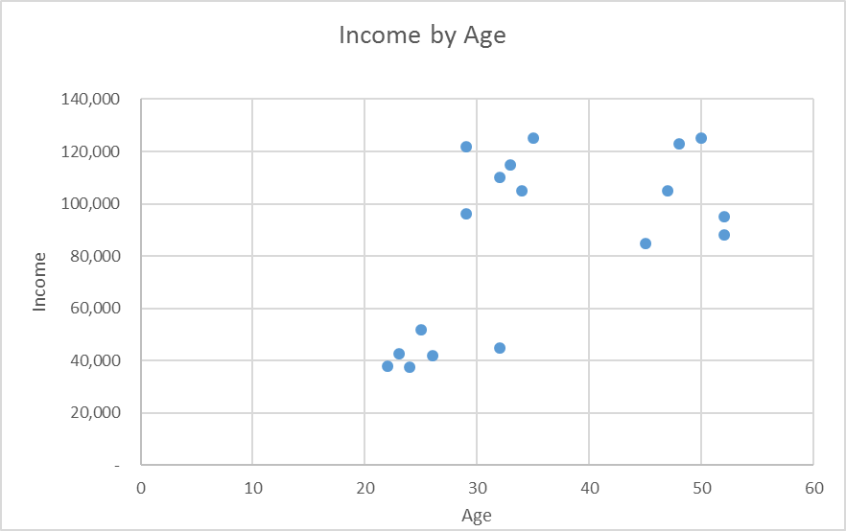

Slide 29
Case Study
Case Study
Donor Segmentation
Purpose
Segment the donor database by inclination and capacity for communication and engagement purposes.

Slide 30
Supervised Modeling
The model training process:
A historical data set (training set) is used where the predictors and target are known.
The model algorithm find relationships between the predictors and the target and creates a statistical model.
The model is then applied to a different data set (scoring set) in which the target is unknown and the model predicts the outcome and the probability of the outcome. This is referred to as Scoring or Deploying the new data set.
Microsoft Azure has two methods for Deploying(Scoring) a new data set: A) Score Model module – add the new data set to the model (Batch Method). B) Setup as a web service API to deploy as a part of other programs (Add Data Individually).

Slide 31
Machine Learning – Linear Regression

Slide 32
Linear Regression:
Regression is a popular method to discover a relationship between variables
In linear regression, we evaluate whether one variable, the dependent or target variable (Y on a graph), can be explained as a function of another, called the independent or predictor variable (X). When there are two or more independent variables it’s called multiple regression.
A regression line is drawn to minimize the sum of squared deviations and this line can be used to predict Y values for new values of X. The mathematical formula is Y=a+bX – where a is the intercept and b is the slope.
Linear regression is used when we have numeric predictor variables and a numeric target variable (i.e. predict donations from the amount of fundraising expenditures).

Slide 33
Donations vs Fundraising Spend

Slide 34
Multiple Linear Regression – Next Ask Amount
TRAINING DATA SET
 |  |  |  | PREDICT
 |  |  |  | DEPENDENT VARIABLE
INDEPENDENT VARIABLES (PREDICTORS) |  |  |  | TARGET (LABEL)
Median Income | Age | # of Children | # of Events Attended | Average Gift
116,310 | 29 | 2 | 3 | 250
64,277 | 32 | 1 | 1 | 100
86,585 | 33 | 4 | 1 | 125
98,268 | 45 | 0 | 2 | 150
69,624 | 52 | 0 | 0 | 100
136,371 | 42 | 3 | 3 | 350

Slide 35
Interpret Regression Analysis Results
Result metrics provided by Regression include:
R squared (the Coefficient of Determination) – measures how close the data is to the fitted regression line – is between 0 and 1 – the closer to 1 the better the model. Normally > .70 is acceptable.
Mean Absolute Error – tells the difference between the predicted value and the actual value – how large an error we can expect from the model.

Slide 36
Case Studies
Case Study
Linear Regression – Next Ask Amount
Purpose
Predict Next Ask Amount

Slide 37
Machine Learning – Logistic Regression

Slide 38
Logistic Regression
Logistic regression estimates the probability of a binary categorical target based on one or more predictor or independent variables. Categorical variables are typically non-numeric and binary is data that can only take on two values (i.e. yes/no; success/failure) . These types of models are referred to as Classification Models. If a model has a numeric target, such as linear regression, it’s referred to as a Regression Model.
Logistic regression can answer questions such as the probability that a donor will make a major gift or that a donor will churn.
Unlike linear regression which has a numerical target and fits to a straight line, logistic regression fits to an S-shaped curve – the so called sigmoid curve.
Logistic regression normally requires numeric input (predictor) variables but if there are categorical input variables, Microsoft Azure will convert them with Dummy Variables.
Logistic regression will generate a prediction (i.e. churn – yes/no) and a confidence percentage.

Slide 39
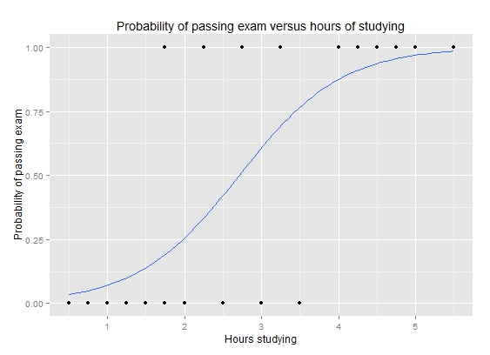
Classification Models
In a classification model like Logistic regression, the goal is to predict what target class a data set belongs to.
For example, if we have a set of predictors for credit scoring such as age, education, income, debt/ratio we could have a target of loan default yes/no.
In the model training process, a historical data set (training set) is used where the predictors and target are known.
The classification algorithm find relationships between the predictors and the target.
These relationships are then applied to a different data set (scoring set) in which the target is unknown and the model predicts the outcome i.e. in our example default yes/no and the probability of this classification.

Slide 40
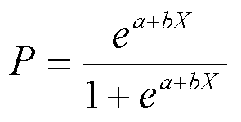
Logistic Regression Equation

Slide 41
Logistic Regression – Donor Churn
TRAINING DATA SET
 |  |  |  |  |  |  |  |  | PREDICT
 |  |  |  |  |  |  |  |  | DEPENDENT VARIABLE
INDEPENDENT VARIABLES (PREDICTORS) |  |  |  |  |  |  |  |  | TARGET (LABEL)
Median Income | Age | Gender | Professional | Home Ownership | Marital Status | # of Events Attended | Total Lifetime Gifts | Prev YR 1 Giving | Churn
115,250 | 34 | Male | Yes | No | Married | 1 | 500 | 100 | Yes
95,700 | 46 | Female | Yes | Yes | Married | 4 | 350 | 100 | No
84,525 | 66 | Male | Yes | No | Single | 2 | 700 | 200 | No
185,790 | 43 | Female | Yes | Yes | Married | 6 | 2,900 | 1,000 | No
80,980 | 33 | Male | No | No | Single | 0 | 625 | 500 | Yes
99,125 | 27 | Male | Yes | Yes | Single | 4 | 450 | 100 | No

Slide 42
Logistic Regression – Donor Churn
SCORING DATA SET
 |  |  |  |  |  |  |  |  | PREDICT
 |  |  |  |  |  |  |  |  | DEPENDENT VARIABLE
INDEPENDENT VARIABLES (PREDICTORS) |  |  |  |  |  |  |  |  | TARGET (LABEL)
Median Income | Age | Gender | Professional | Home Ownership | Marital Status | # of Events Attended | Total Lifetime Gifts | Prev YR 1 Giving | Churn
113,131 | 32 | Male | Yes | Yes | Single | 2 | 550 | 100 | ?
91,604 | 48 | Female | Yes | Yes | Married | 4 | 300 | 125 | ?
94,525 | 66 | Male | No | No | Single | 1 | 700 | 200 | ?
179,792 | 46 | Female | Yes | Yes | Married | 7 | 3,100 | 1,500 | ?
75,850 | 26 | Male | No | No | Single | 0 | 625 | 550 | ?
93,512 | 27 | Female | Yes | Yes | Single | 3 | 500 | 100 | ?

Slide 43
Classification Model Evaluation
It’s also critical to evaluate the effectiveness of the classification model.
The model is tested by setting aside a portion of the training data set which is referred to as the test data set.
The test data set is run through the model and the results are compared to the original known values.
The result is called a confusion matrix and it displays the number of correct and incorrect predictions.

Slide 44
Confusion Matrix
The confusion matrix summarized the following correct/incorrect predictions:
True Positive – actual class was positive and was predicted as positive.
False Positive – actual class was negative and was predicted as positive.
True Negative – actual class was negative and it was predicted as negative.
False negative – actual class was positive but was predicted as negative.

Slide 45
Classification Model Evaluation
Some important metrics include the following:
Receiver Operator Characteristic (ROC) Curve – Graphically plots the rate of true positives to false positives. Generally the larger the “Area Under the Curve” the better the model. Rule of thumb > .80 is a good model.
Accuracy – what % of all predictions are correct.
Recall or Sensitivity - the proportion of actual positive cases that are correctly classified.

Slide 46
Case Study
Case Study
Donor Churn
Purpose
Predict those donors who are most likely to churn

Slide 47
Machine Learning - Decision Trees

Slide 48
Decision Trees
Decision trees are one of the most popular techniques for classification. Like logistic regression, decision trees can also be used for categorical targets. For example, in our case study we’ll predict possible major donors from a donor database.
A decision tree is in the form of a decision flowchart (resembles an inverted tree) where the predictor variables are tested in each node and are split in accordance with importance based on the particular algorithm’s criteria.
At the bottom of the decision tree branch is a leaf node where a prediction about the target variable is made based on the variables leading to that leaf node.

Slide 49
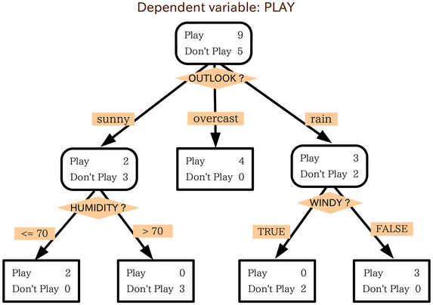
Decision Trees:
Decision trees are one of the most popular techniques for classification.
A decision tree is in the form of a decision flowchart (resembles an inverted tree) where the predictor variables are tested in each node and are split in accordance with importance based on the particular algorithm’s criteria.
At the bottom of the decision tree branch is a leaf node where a prediction about the target variable is made based on the variables leading to that leaf node.
Decision Trees:
Decision trees are one of the most popular techniques for classification.
A decision tree is in the form of a decision flowchart (resembles an inverted tree) where the predictor variables are tested in each node and are split in accordance with importance based on the particular algorithm’s criteria.
At the bottom of the decision tree branch is a leaf node where a prediction about the target variable is made based on the variables leading to that leaf node.
Decision Trees:
Decision trees are one of the most popular techniques for classification.
A decision tree is in the form of a decision flowchart (resembles an inverted tree) where the predictor variables are tested in each node and are split in accordance with importance based on the particular algorithm’s criteria.
At the bottom of the decision tree branch is a leaf node where a prediction about the target variable is made based on the variables leading to that leaf node.
Decision trees are one of the most popular techniques for classification.

Slide 50
Decision Trees - continued
Some of the most popular decision tree algorithms are: ID3, CART and CHAID. They vary primarily due to the process used for splitting the variables by importance in each node.
s are popular for the following reasons:
Decision trees are popular for the following reasons:
They are easy to understand.
They are easy to build.
The input predictor variable can be categorical or numeric.
They can handle missing data automatically.They are easy to understand.
They are easy to build.
The input predictor variables can be nominal or continuous.
They can handle missing data automatically.

Slide 51
Case Study
Case Study
Major Donor Prediction
Purpose
Predict those donors most likely to make a major donation

